Slide 1
UNIT – 4 TRANSDUCERS
Prepared By
Dr. M. Arun Noyal Doss
Associate Professor/EEE,
SRMIST-KTR

Slide 2
TRANSDUCERS
A transducer is a device that converts energy from one form to another.
Any device or component that converts an input signal of one form to an output signal of another form.
An element or device which receives information in the form of one quantity and converts it to information in the same or an other quantity or form.
A device for translating the magnitude of one quantity into another quantity.
Energy forms can be mechanical, visual, aural, electrical, thermal, chemical, etc. (examples to follow).
Used to change information into a form that can be easily transferred, stored, processed, interpreted, etc.

Slide 3
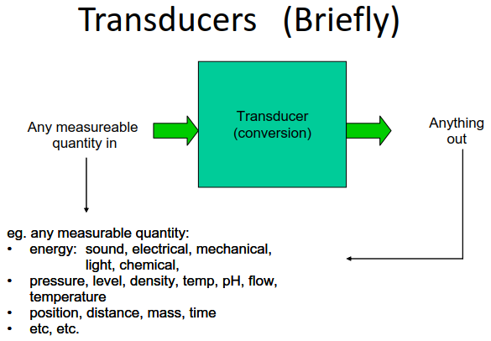

Slide 4
Basic Requirements of Transducer
Linearity: Linearity of any transducer is the prime requirement. A transducer having linear input output characteristics is a big plus.
Repeatability: A transducer having this quality produces the same result again and again when the same input signal is applied repeatedly under same environmental conditions ex. Temperature, pressure, humidity etc.
Ruggedness: A transducer should be robust in construction. It should be mechanically rugged, so that is capable of withstanding overload.
High Signal To Noise Ratio: The quality of output signal of transducer should be good; it should be free from the internal and external noise.
Highly Reliable: Output of the transducer should be highly reliable and stable it should be precise. It should give minimum error in measurement for temperature variations, humidity vibrations.
Good Dynamic Response: A transducer may be called upon to respond to either slowly varying or dynamic signals. Its output should be faithful to input when taken as a function of time.
No Hysteresis: A good transducer is free from hysteresis. It should not introduce any hysteresis during measurement while input signal is varied from its low value to high value and vice versa.
Residual Deformation: There should be no deformation of testing material after the removal of any pressure after long period of application.

Slide 5
Transducers can be classified as
On the basis of transduction form used.
Primary and secondary transducers.
Passive and active transducers.
Analog and digital transducers.
As transducers and inverse transducers.

Slide 6
Introduction of Transducers
Transducers are divided into two types:
Active Transducer
Passive Transducer

Slide 7
Active Transducers
An active transducer does not require an external power supply to provide an output signal.
These transducers usually rely upon magnetic inductance or piezoelectric effects to produce their output signals.
Ex. Piezoelectric crystal used for acceleration measurement.
Measurand is converted into output without any other form of energy requirements.
They are also called self generating type transducers.

Slide 8
Passive Transducers
Passive transducers need an external power supply in order to amplifies the input and generate an output signal.
All passive transducers change one of, or a combination of, the three general circuit parameters; resistance, inductance, or capacitance.
Ex. Potentiometer is used for measurement of pressure, displacement and position.

Slide 9
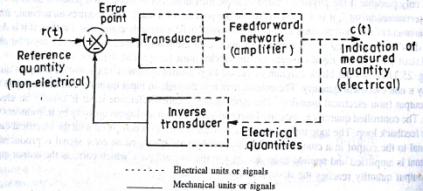
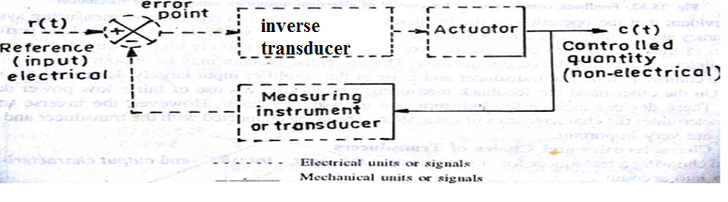
Direct and Inverse Transducers
Direct-one form to electrical
Example :microphone [sound-electrical]
Inverse-electrical into non-electrical
Example:loudspeaker[electrical-sound]

Slide 10
Displacement Transducer
A Displacement Transducer is an electromechanical device used to convert mechanical motion or vibrations, specifically rectilinear motion, into a variable electrical current, voltage or electric signals, and the reverse.
Capacitive Transducer
Inductive
Variable Inductance
Linear Variable Differential Transformer

Slide 11
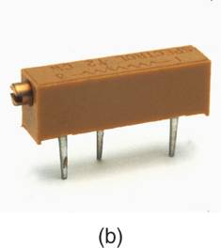
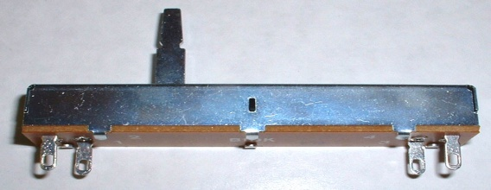
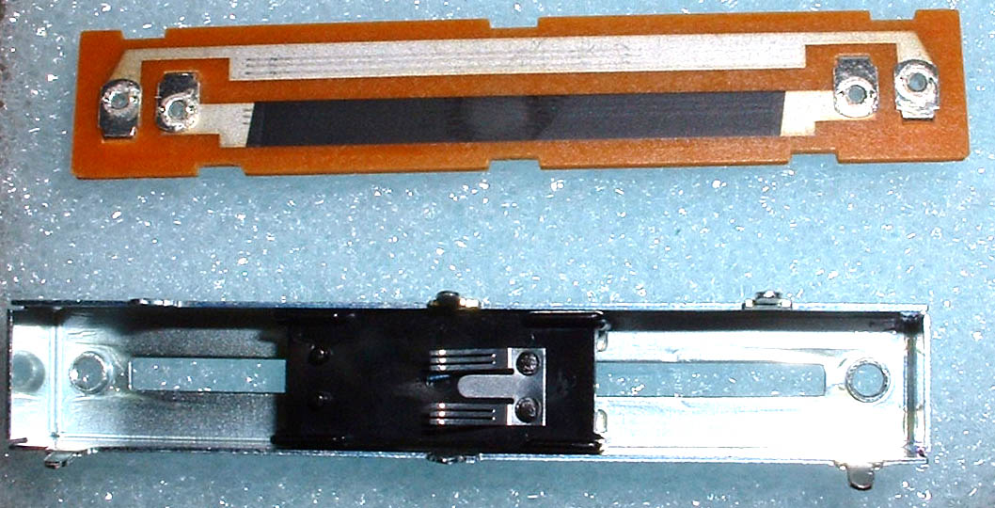
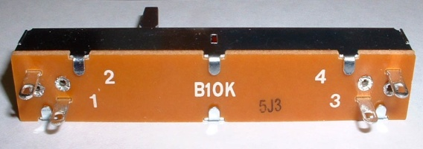
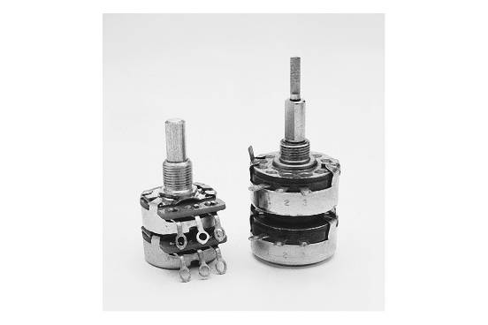
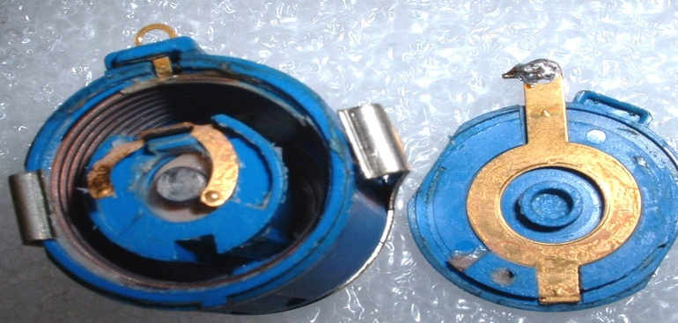
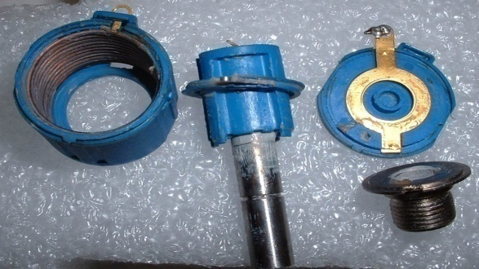
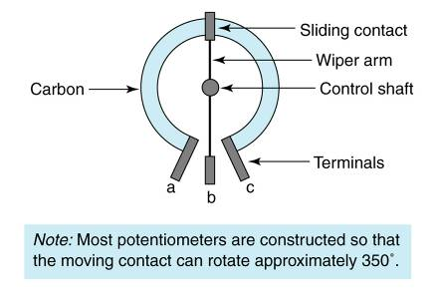
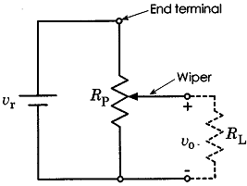
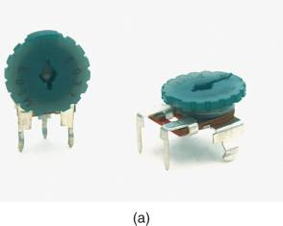
Variation of resistance

Slide 12
Capacitance Transducers
Variable capacitance pressure gage –
Principle of operation: Distance between two parallel plates is varied by an externally applied force.
Applications: Measurement of Displacement, pressure.
Capacitor microphone
Principle of operation: Sound pressure varies the capacitance between a fixed plate and a movable diaphragm.
Applications: Speech, music, noise.
Dielectric gauge
Principle of operation: Variation in capacitance by changes in the dielectric.
Applications: Liquid level, thickness.

Slide 13
Inductance Transducers
Magnetic circuit transducer
Principle of operation: Self inductance or mutual inductance of ac-excited coil is varied by changes in the magnetic circuit.
Applications: Pressure, displacement.
Reluctance pickup
Principle of operation: Reluctance of the magnetic circuit is varied by changing the position of the iron core of a coil.
Applications: Pressure, displacement, vibration, position.
Differential transformer
Principle of operation: The differential voltage of two secondary windings of a transformer is varied by positioning the magnetic core through an externally applied force.
Applications: Pressure, force, displacement, position.
Eddy current gage
Principle of operation: Inductance of a coil is varied by the proximity of an eddy current plate.
Applications: Displacement, thickness.
Magnetostriction gauge
Principle of operation: Magnetic properties are varied by pressure and stress.
Applications: Force, pressure, sound.

Slide 14
Transducer Types
Electromagnetic Transducer
Electrochemical Transducer
Electromechanical Transducer
Electro acoustic Transducer
Photoelectric Transducer
Electrostatic Transducer
Thermoelectric Transducer
Radio acoustic Transducer

Slide 15
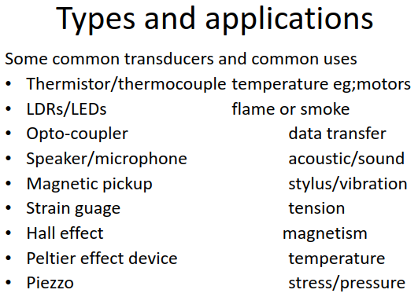

Slide 16
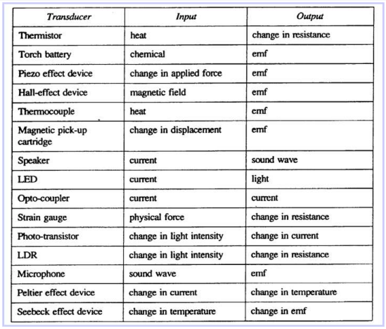

Slide 17
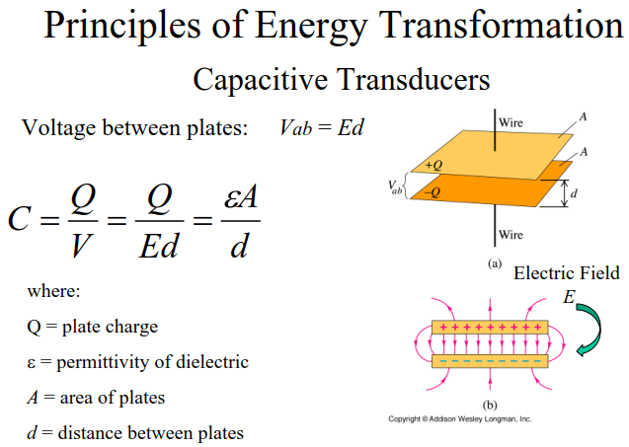

Slide 18
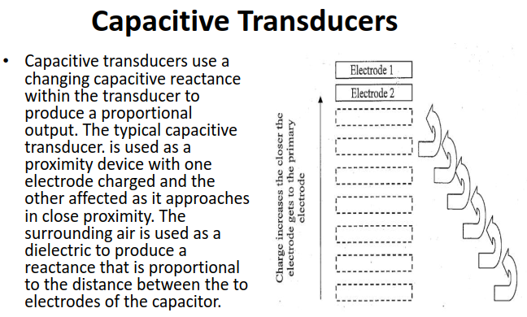

Slide 19
Inductive Transducers
Inductive transducers work on the principle of inductance change due to any appreciable change in the quantity to be measured i.e. measured.
For example, LVDT, a kind of inductive transducers, measures displacement in terms of voltage difference between its two secondary voltages.
Secondary voltages are nothing but the result of induction due to the flux change in the secondary coil with the displacement of the iron bar.
Anyway, LVDT is discussed here briefly to explain the principle of inductive transducer.

Slide 20
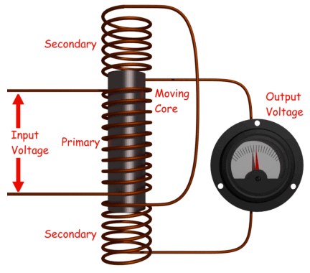

Slide 21
Linear variable differential transformer (LVDT)
When an externally applied force moves the core to the left-hand position, more magnetic flux links the left-hand coil than the right hand coil.
The emf induced in the left-hand coil [Es1], is therefore larger than the induced emf of the right-hand coil [Es2].
The magnitude of the output voltage is then equal to the difference between the two secondary voltages and it is in phase with the voltage of the left-hand coil.

Slide 22
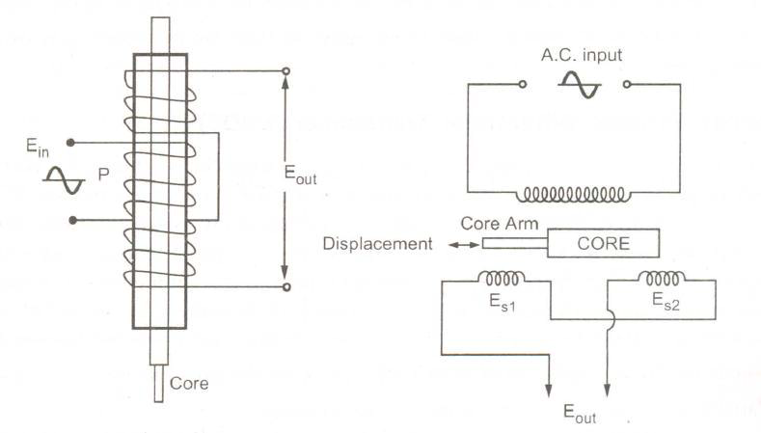

Slide 23
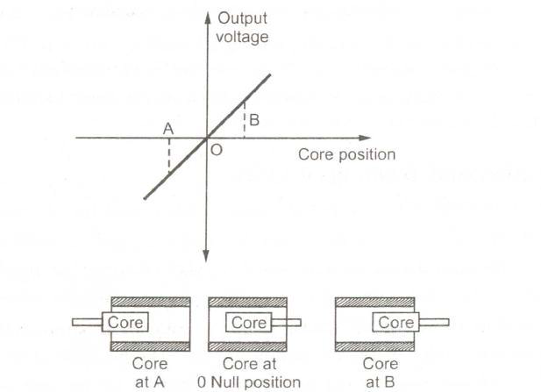

Slide 24
Construction of LVDT
The transformer consists of a primary winding P and two secondary winding S1 and S2 wound on a cylindrical former(which is hollow in nature and will contain core).
Both the secondary windings have equal number of turns and are identically placed on the either side of primary winding.
The primary winding is connected to an AC source which produces a flux in the air gap and voltages are induced in secondary windings.
A movable soft iron core is placed inside the former and displacement to be measured is connected to the iron core.
The iron core is generally of high permeability which helps in reducing harmonics and high sensitivity of LVDT.
The LVDT is placed inside a stainless steel housing because it will provide electrostatic and electromagnetic shielding.
The both the secondary windings are connected in such a way that resulted output is the difference of the voltages of two windings.

Slide 25
Principle of Operation and Working
As the primary is connected to an AC source so alternating current and voltages are produced in the secondary of the LVDT. The output in secondary S₁ is e₁ and in the secondary S₂ is e₂. So the differential output is, e_{out} = e₁ - e₂ This equation explains the principle of Operation of LVDT.
Now three cases arise according to the locations of core which explains the working of LVDT are discussed below as,
CASE I When the core is at null position (for no displacement) When the core is at null position then the flux linking with both the secondary windings is equal so the induced emf is equal in both the windings. So for no displacement the value of output e_{out} is zero as e₁ and e₂ both are equal. So it shows that no displacement took place.
CASE II When the core is moved to upward of null position (For displacement to the upward of reference point) In the this case the flux linking with secondary winding S₁ is more as compared to flux linking with S₂. Due to this e₁ will be more as that of e₂. Due to this output voltage e_{out} is positive.
CASE III When the core is moved to downward of Null position (for displacement to the downward of reference point) In this case magnitude of e₂ will be more as that of e₁. Due to this output e_{out} will be negative and shows the output to downward of reference point.

Slide 26
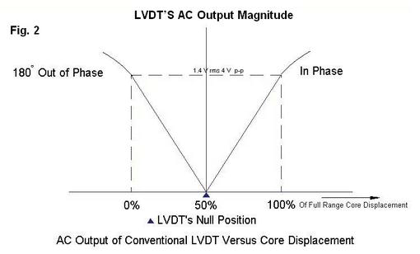
Output Vs Core Displacement: A linear curve shows that output voltage varies linearly with displacement of core.

Slide 27
Some important points about magnitude and sign of voltage induced in LVDT:
The amount of change in voltage either negative or positive is proportional to the amount of movement of core and indicates amount of linear motion.
By noting the output voltage increasing or decreasing the direction of motion can be determined.
The output voltage of an LVDT is linear function of core displacement.

Slide 28
Advantages of LVDT
High Range - The LVDTs have a very high range for measurement of displacement. They can used for measurement of displacements ranging from 1.25mm to 250mm.
No Frictional Losses - As the core moves inside a hollow former so there is no loss of displacement input as frictional loss so it makes LVDT as very accurate device.
High Input and High Sensitivity - The output of LVDT is so high that it doesn’t need any amplification. The transducer possesses a high sensitivity which is typically about 40V/mm.
Low Hysteresis - LVDTs show a low hysteresis and hence repeatability is excellent under all conditions.
Low Power Consumption - The power is about 1W which is very as compared to other transducers.
Direct Conversion to Electrical Signals - They convert the linear displacement to electrical voltage which are easy to process.

Slide 29
Disadvantages of LVDT
LVDT is sensitive to stray magnetic fields so they always require a setup to protect them from stray magnetic fields.
They are affected by vibrations and temperature.
Applications of LVDT
They are used in applications where displacements ranging from fraction of mm to few cm are to be measured. The LVDT acting as a primary Transducer converts the displacement to electrical signal directly.
They can also acts as the secondary transducers. E.g. the Bourbon tube which acts as a primary transducer and covert pressure into linear displacement. Then LVDT coverts this displacement into electrical signal which after calibration gives the ideas of the pressure of fluid.

Slide 30
Electromechanical Transducers
Galvanometer-an instrument for detecting and measuring electric current. It is an analog electromechanical transducer that produces a rotary deflection, through a limited arc, in response to electric current flowing through its coil.
Accelerometer- a device for measuring acceleration and gravity induced reaction forces.
Rotary motor, linear motor , Vibration powered generator are some examples of this type.

Slide 31
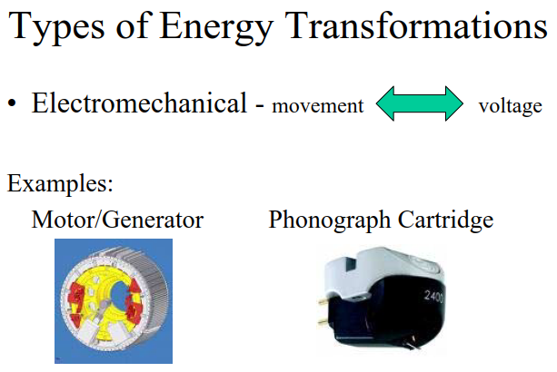

Slide 32
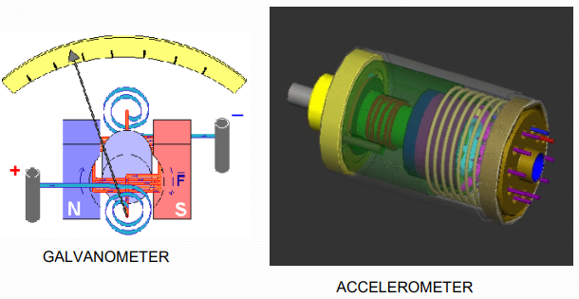

Slide 33
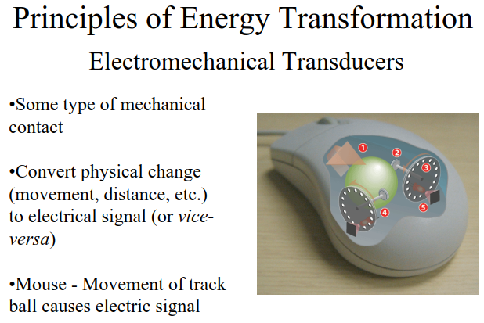

Slide 34
Strain Gauge Pressure Transducer
When the tension is applied to the electrical conductor, its length increases while the cross section area decreases.
So its resistance changes.
This change can be measured to measured.
Used for the measurement of force, stress and strain.
A strain gauge is a passive type resistance pressure transducer whose electrical resistance changes when it is stretched or compressed.
A pressure transducer contains a diaphragm which is deformed by the pressure which can cause a strain gauge to stretch or compress. This deformation of the strain gauge causes the variation in length and cross sectional area due to which its resistance changes.

Slide 35
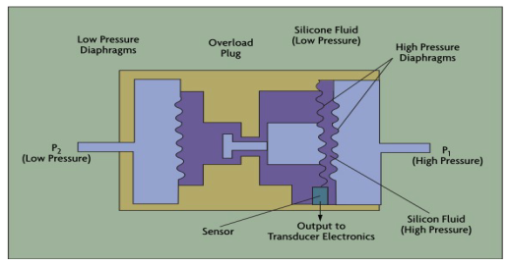
The wire filament is attached to a structure under strain and the resistance in the strained wire is measured.

Slide 36
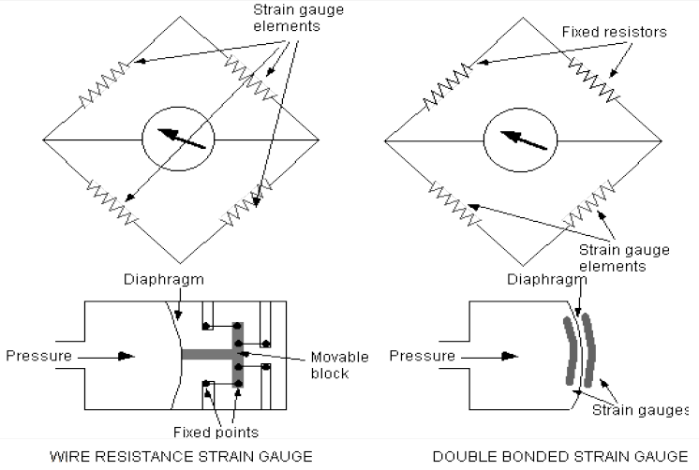

Slide 37
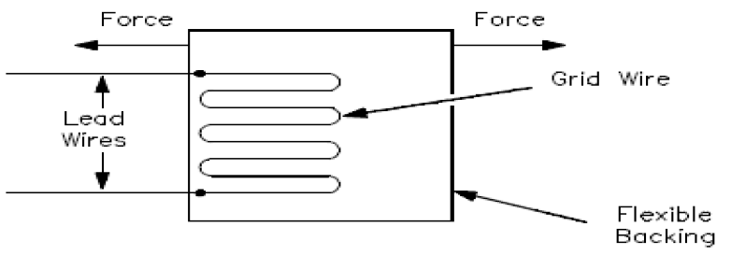
Strain gauge pressure transducers are used for narrow pressure span and for differential pressure measurements.
Available for pressure ranges as low as 3 inches of water to as high as 200,000 psig.
Inaccuracy ranges from 0.1 % of span to 0.25 % of full scale.

Slide 38
Thermoelectric Transducers
RTD(Resistance Temperature Detector)-To predict change in electrical resistance of some materials with changing temperature.
Thermocouple-to convert thermal potential difference into electric potential difference.
Thermistor are some of the examples of this type of transducers.

Slide 39
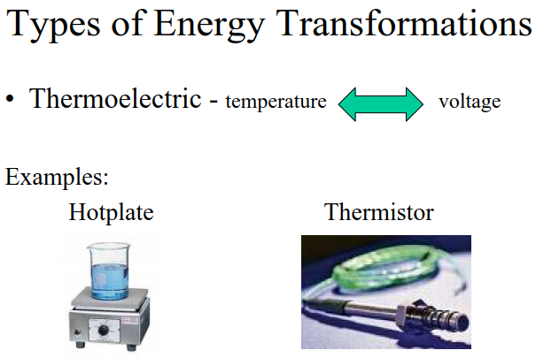

Slide 40
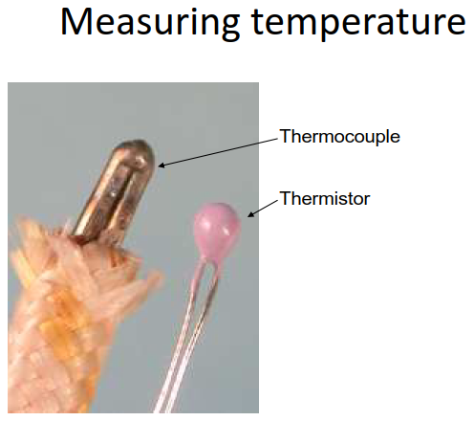

Slide 41
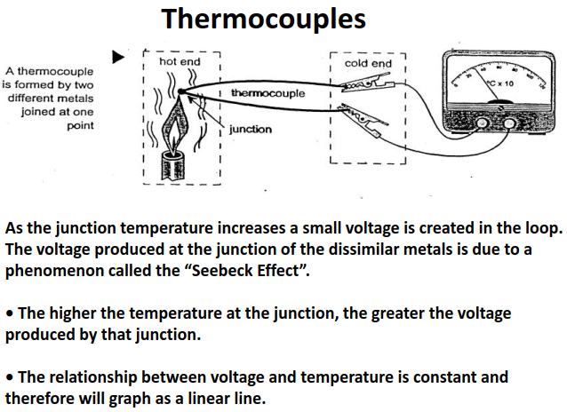

Slide 42
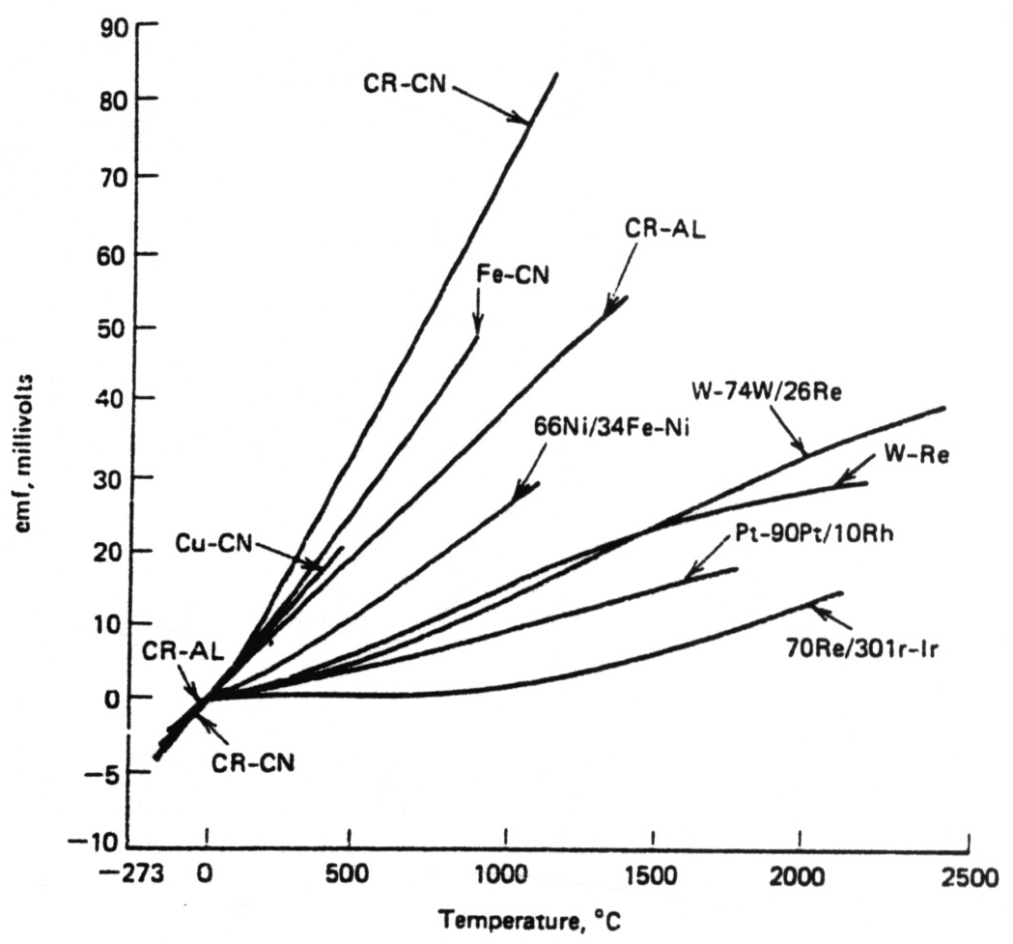
Temperature Transducer (cont’d):- 2. Thermocouples:-
Fig (11) Calibration curves for several thermocouple combi­nations.

Slide 43
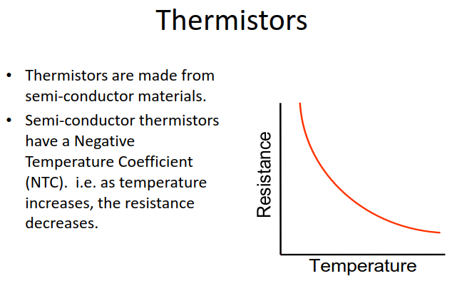

Slide 44
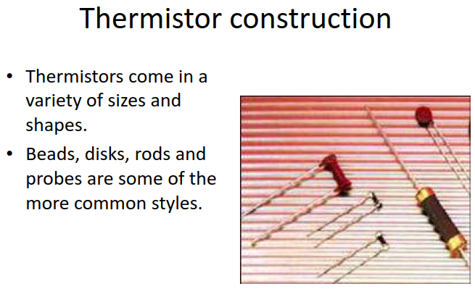

Slide 45
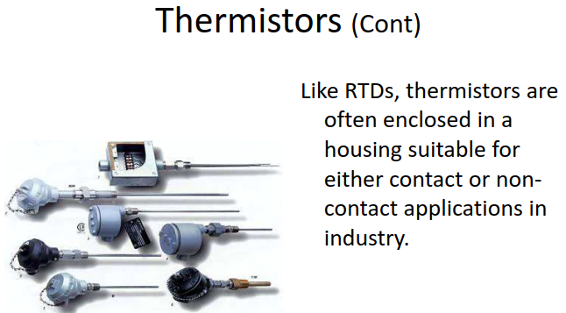

Slide 46
RESISTANCE TEMPERATURE DETECTOR (RTD)
Resistance temperature detector (RTD) devices are conductors used for temperature sensing.
They can be used in bridge method as well as ohmmeter method to take the output.
The change in resistance of material per unit change in temperature should be as large as possible.
The material should have high value of resistivity to get required value in less space.
Resistance and temperature relation should be continuous and stable.
Platinum, nickel and copper are the most commonly used.
Tungsten and nickel alloy are also used.
APPLICATIONS OF RTD:
They can be used in average and differential temp. measurement.
Differential temp. sensing to an accuracy of 0.05° have been accomplished in a nuclear reactor coolant heat rise application.

Slide 47
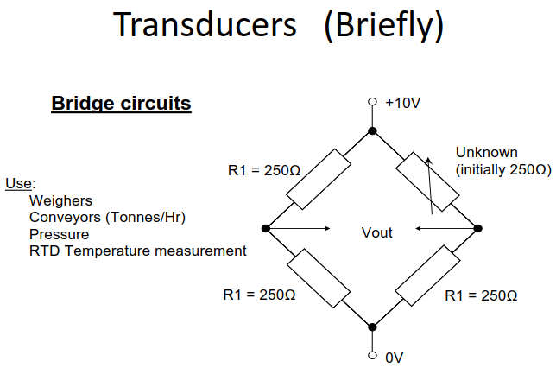

Slide 48
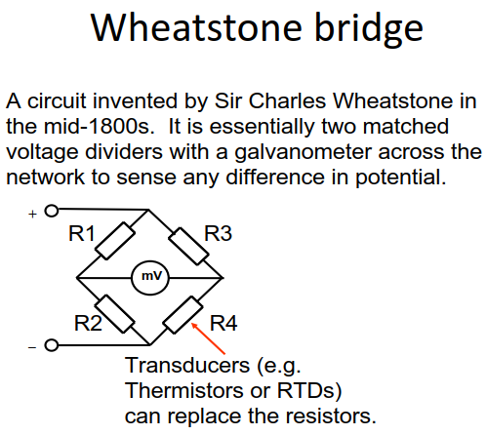

Slide 49
Photoelectric Transducers
Laser diode, light-emitting diode - convert electrical power into forms of light.
Photodiode, photo resistor, phototransistor, photomultiplier tube - converts changing light levels into electrical form.

Slide 50
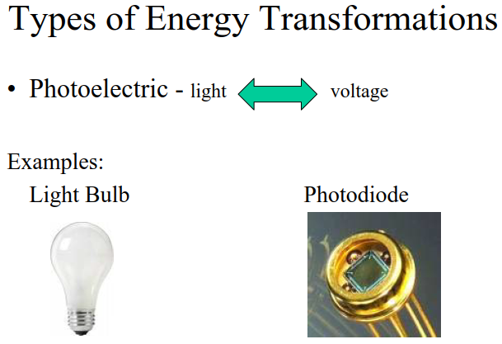

Slide 51
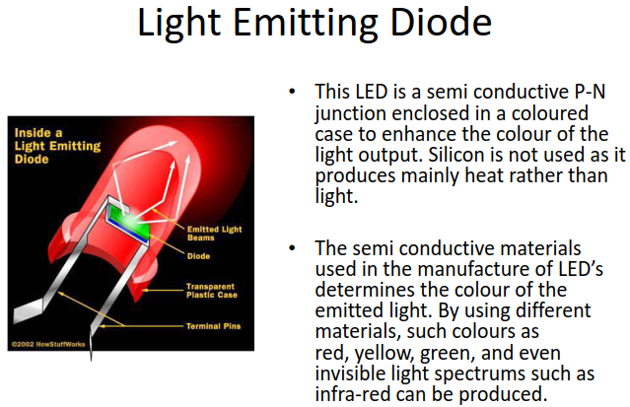

Slide 52
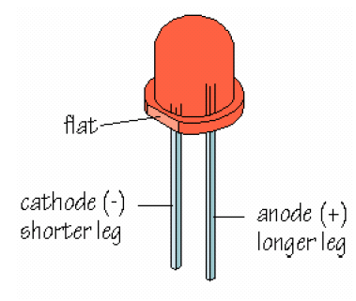

Slide 53
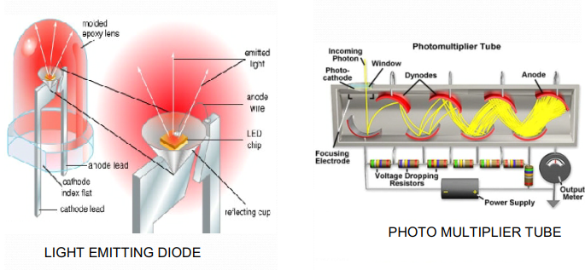

Slide 54
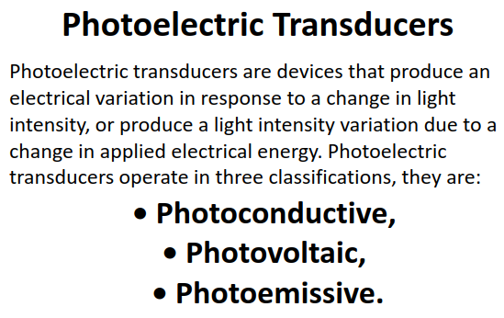

Slide 55
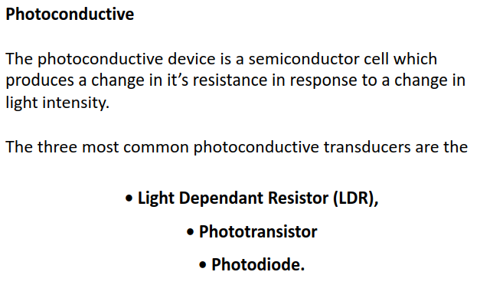

Slide 56
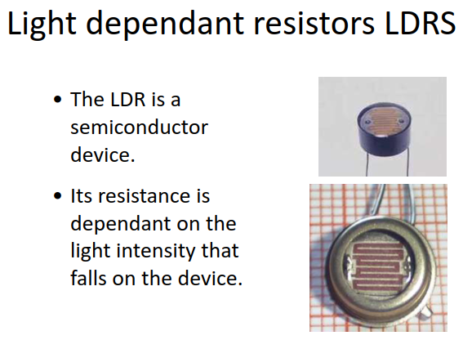

Slide 57
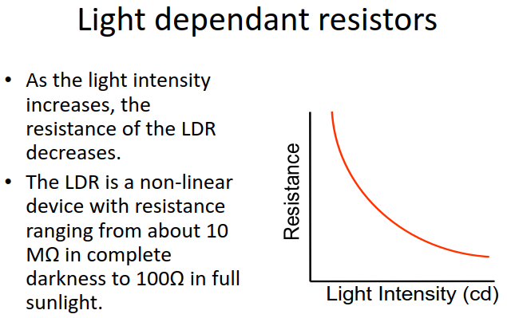

Slide 58
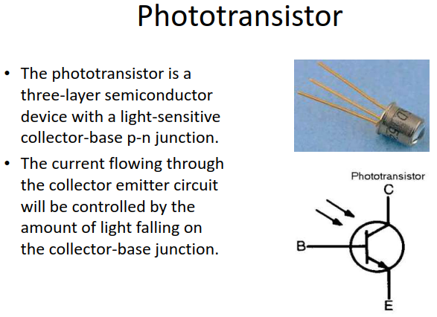

Slide 59
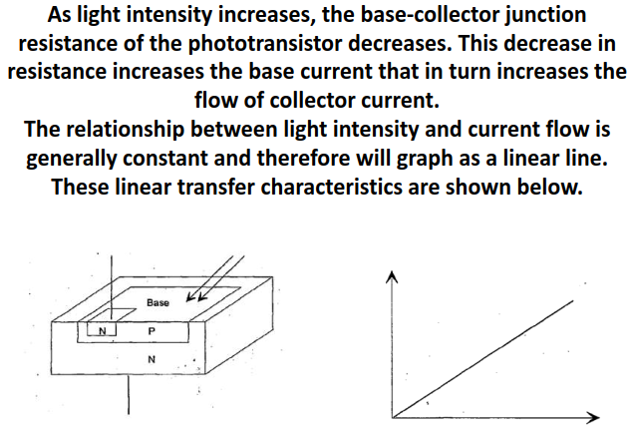

Slide 60
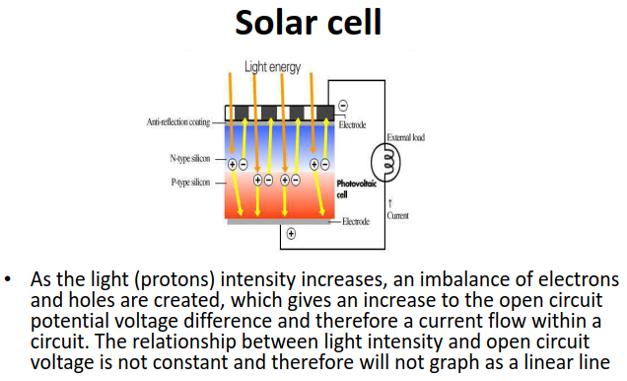

Slide 61
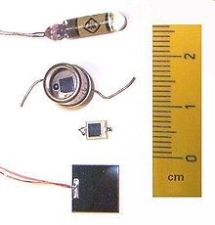
Photodiode
A photodiode is a semiconductor device that converts light into an electrical current. The current is generated when photons are absorbed in the photodiode.
Photodiodes may contain optical filters, built-in lenses, and may have large or small surface areas.
Photodiodes usually have a slower response time as their surface area increases.

Slide 62
Principle of operation
A photodiode is a p–n junction or PIN structure. When a photon of sufficient energy strikes the diode, it creates an electron–hole pair. This mechanism is also known as the inner photoelectric effect.
If the absorption occurs in the junction's depletion region, or one diffusion length away from it, these carriers are swept from the junction by the built-in electric field of the depletion region.
Thus holes move toward the anode, and electrons toward the cathode, and a photocurrent is produced.
The total current through the photodiode is the sum of the dark current (current that is generated in the absence of light) and the photocurrent, so the dark current must be minimized to maximize the sensitivity of the device.

Slide 63
Photovoltaic mode:
When used in zero bias or photovoltaic mode, photocurrent flows out of the anode through a short circuit to the cathode.
If the circuit is opened or has a load impedance, restricting the photocurrent out of the device, a voltage builds up in the direction that forward biases the diode, that is, anode positive with respect to cathode.
If the circuit is shorted or the impedance is low, a forward current will consume all or some of the photocurrent. This mode exploits the photovoltaic effect, which is the basis for solar cells – a traditional solar cell is just a large area photodiode.
For optimum power output, the photovoltaic cell will be operated at a voltage that causes only a small forward current compared to the photocurrent.
Photoconductive mode:
In this mode the diode is reverse biased (with the cathode driven positive with respect to the anode). This reduces the response time because the additional reverse bias increases the width of the depletion layer, which decreases the junction's capacitance and increases the region with an electric field that will cause electrons to be quickly collected. The reverse bias also reduces the dark current without much change in the photocurrent.
Although this mode is faster, the photoconductive mode can exhibit more electronic noise due to dark current or avalanche effects.^{[4]} The leakage current of a good PIN diode is so low (<1 nA) that the Johnson–Nyquist noise of the load resistance in a typical circuit often dominates.

Slide 64
Laser diode
A laser diode, (LD), injection laser diode (ILD), or diode laser is a semiconductor device similar to a light-emitting diode in which a diode pumped directly with electrical current can create lasing conditions at the diode's junction.
Laser diodes can directly convert electrical energy into light. Driven by voltage, the doped p-n-transition allows for recombination of an electron with a hole. Due to the drop of the electron from a higher energy level to a lower one, radiation, in the form of an emitted photon is generated.
This is spontaneous emission. Stimulated emission can be produced when the process is continued and further generate light with the same phase, coherence and wavelength.

Slide 65
Principle of operation
A laser diode is electrically a PIN diode. The active region of the laser diode is in the intrinsic (I) region, and the carriers (electrons and holes) are pumped into that region from the N and P regions respectively.
While initial diode laser research was conducted on simple P-N diodes, all modern lasers use the double-hetero-structure implementation, where the carriers and the photons are confined in order to maximize their chances for recombination and light generation.
Unlike a regular diode, the goal for a laser diode is to recombine all carriers in the I region, and produce light. Thus, laser diodes are fabricated using direct band-gap semiconductors.
The laser diode epitaxial structure is grown using one of the crystal growth techniques, usually starting from an N doped substrate, and growing the I doped active layer, followed by the P doped cladding, and a contact layer.
The active layer most often consists of quantum wells, which provide lower threshold current and higher efficiency.

Slide 66
Electroacoustic Transducers
Geophone - convert a ground movement (displacement) into voltage .
Hydrophone - converts changes in water pressure into an electrical form.
Loudspeaker, earphone - converts changes in electrical signals into acoustic form.
Microphone - converts changes in air pressure into an electrical signal.

Slide 67
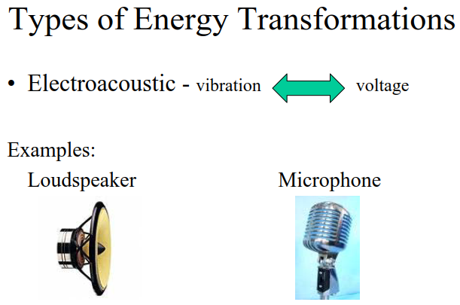

Slide 68
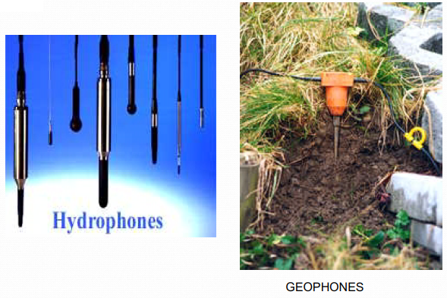

Slide 69


Slide 70
Electromagnetic Transducers
Antenna - converts electromagnetic waves into electric current and vice versa.
Cathode ray tube (CRT) - converts electrical signals into visual form
Fluorescent lamp, light bulb - converts electrical power into visible light
Tape head - converts changing magnetic fields into electrical form

Slide 71


Slide 72


Slide 73


Slide 74


Slide 75


Slide 76


Slide 77
Electrochemical Transducers
pH probes-an electronic instrument used to measure the pH (acidity or basicity) of a liquid.
An electro galvanic fuel cell- an electrical device used to measure the concentration of oxygen gas in medical equipment.

Slide 78


Slide 79


Slide 80

Electrostatic Transducers
Electrometer-an electrical instrument for measuring electric charge or electrical potential difference.

Slide 81

Radioacoustic Transducers
Geiger-Muller tube used for measuring radioactivity.
Radio Receiver.

Slide 82

LCD
A liquid crystal display or LCD draws its definition from its name itself. It is combination of two states of matter, the solid and the liquid.
LCD uses a liquid crystal to produce a visible image. Liquid crystal displays are super-thin technology display screen that are generally used in laptop computer screen, TVs, cell phones and portable video games.
LCD’s technologies allow displays to be much thinner when compared to cathode ray tube (CRT) technology.

Slide 83

LCD

Slide 84


Slide 85
LCD
The principle behind the LCD’s is that when an electrical current is applied to the liquid crystal molecule, the molecule tends to untwist.
This causes the angle of light which is passing through the molecule of the polarized glass to change and also cause a change in the angle of the top polarizing filter.
As a result a little light is allowed to pass the polarized glass through a particular area of the LCD.
Thus that particular area will become dark compared to other.
The LCD works on the principle of blocking light.
While constructing the LCD’s, a reflected mirror is arranged at the back. An electrode plane is made of indium-tin oxide which is kept on top and a polarized glass with a polarizing film is also added on the bottom of the device.
The complete region of the LCD has to be enclosed by a common electrode and above it should be the liquid crystal matter.

Slide 86
LCD
Next comes to the second piece of glass with an electrode in the form of the rectangle on the bottom and, on top, another polarizing film.
It must be considered that both the pieces are kept at right angles.
When there is no current, the light passes through the front of the LCD it will be reflected by the mirror and bounced back.
As the electrode is connected to a battery the current from it will cause the liquid crystals between the common-plane electrode and the electrode shaped like a rectangle to untwist.
Thus the light is blocked from passing through. That particular rectangular area appears blank.

Slide 87
Antenna
An antenna is a specialized transducer that converts radio-frequency (RF) fields into alternating current (AC) or vice-versa.
An antenna is a metallic structure that captures and/or transmits radio electromagnetic waves.
An antenna produces both electric and magnetic fields that are perpendicular to one another, as well as to the direction of propagation.
At frequencies below 3 GHz, many different types of antennas are used.
Antennas demonstrate a property known as reciprocity, which means that an antenna will maintain the same characteristics regardless if it is transmitting or receiving.
There are two basic types:
Receiving antenna, which intercepts RF energy and delivers AC to electronic equipment
Transmitting antenna, which is fed with AC from electronic equipment and generates an RF field.

Slide 88


Slide 89


Antenna
Fundamentally, from Maxwell’s equations, Electromagnetic waves are generated by accelerating electric currents and conductors carry those currents.
The EM waves that are generated then propagate through space.
The goal of antenna design is to ensure that the conversion between current and radiation occurs as efficiently as possible and that power is transmitted or received with desired characteristics.

Slide 90
Magnetic Cartridge
A magnetic cartridge, more commonly called a phonograph cartridge or phono cartridge or (colloquially) a pickup, is an electromechanical transducer that is used to play records on a turntable.
The basic principle of phonograph sound reproduction stems from a small diameter diamond needle follows a groove cut into the surface of a record.
The resulting needle velocity is mechanically coupled to one element of an electrical coil transducer to produce an electrical current.

Slide 91

Magnetic Cartridge
The cartridge contains a removable or permanently mounted stylus, the tip - usually a gemstone, such as diamond or sapphire - of which makes physical contact with the record's groove.
As the stylus tracks the serrated groove, it vibrates a cantilever on which is mounted a permanent magnet which moves between the magnetic fields of sets of electromagnetic coils in the cartridge.
The shifting magnetic fields generate an electrical current in the coils.
The electrical signal generated by the cartridge can be amplified and then converted into sound by a loudspeaker.

Slide 92
Geiger Muller Tubes
Geiger counter is also called as Geiger tube.
This instrument is actually used for detecting and measuring ionizing radiation like alpha particles, beta particles, and gamma rays.
A Geiger-Müller counter can count individual particles at rates up to about 10,000 per second and is used widely in medicine and in prospecting for radioactive ores.
The unit for measuring radioactive emissions is the becquerel (Bq). The Bq indicates the number of decays per second.

Slide 93

Geiger Muller Tubes
The counter consists of a tube filled with an inert gas that becomes conductive of electricity when it is impacted by a high-energy particle.
When a Geiger counter is exposed to ionizing radiation, the particles penetrate the tube and collide with the gas, releasing more electrons.
Positive ions exit the tube and the negatively charged electrons become attracted to a high-voltage middle wire.
When the number of electrons that build up around the wire reaches a threshold, it creates an electric current.
This causes the temporary closing of a switch and generates an electric pulse that is registered on a meter

Slide 94


Slide 95
Radio Transmitter & Receiver
A radio transmitter consists of several elements that work together to generate radio waves that contain useful information such as audio, video, or digital data.
Power supply: Provides the necessary electrical power to operate the transmitter.
Oscillator: Creates alternating current at the frequency on which the transmitter will transmit. The oscillator usually generates a sine wave, which is referred to as a carrier wave.
Modulator: Adds useful information to the carrier wave. There are two main ways to add this information. The first, called amplitude modulation or AM, makes slight increases or decreases to the intensity of the carrier wave. The second, called frequency modulation or FM, makes slight increases or decreases the frequency of the carrier wave.
Amplifier: Amplifies the modulated carrier wave to increase its power. The more powerful the amplifier, the more powerful the broadcast.
Antenna: Converts the amplified signal to radio waves.

Slide 96


Radio Transmitter & Receiver

Slide 97
Radio Transmitter & Receiver
Radio receiver is the opposite of a radio transmitter. It uses an antenna to capture radio waves, processes those waves to extract only those waves that are vibrating at the desired frequency, extracts the audio signals that were added to those waves, amplifies the audio signals, and finally plays them on a speaker.
Antenna: Captures the radio waves. Typically, the antenna is simply a length of wire. When this wire is exposed to radio waves, the waves induce a very small alternating current in the antenna.
RF amplifier: A sensitive amplifier that amplifies the very weak radio frequency (RF) signal from the antenna so that the signal can be processed by the tuner.
Tuner: A circuit that can extract signals of a particular frequency from a mix of signals of different frequencies. On its own, the antenna captures radio waves of all frequencies and sends them to the RF amplifier, which dutifully amplifies them all.
Detector: Responsible for separating the audio information from the carrier wave. For AM signals, this can be done with a diode that just rectifies the alternating current signal. What’s left after the diode has its way with the alternating current signal is a direct current signal that can be fed to an audio amplifier circuit. For FM signals, the detector circuit is a little more complicated.
Audio amplifier: This component’s job is to amplify the weak signal that comes from the detector so that it can be heard. This can be done using a simple transistor amplifier circuit.

Slide 98
THANK YOU

